Slide 1


Oracle database
Lecture 12

Slide 2

Today’s Agenda
Introduction To STRING Functions
Various STRING Functions Of Oracle
Queries

Slide 3
String Functions In Oracle
Oracle has a huge collection of String Functions .
These functions helps us manipulate the character strings more effectively.

Slide 4
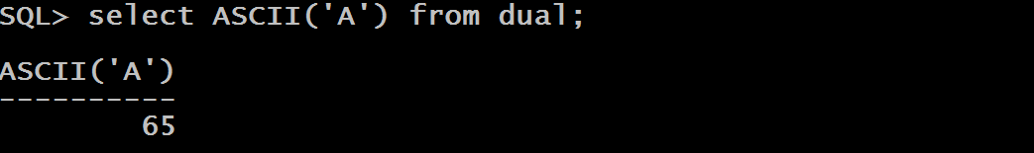
The Function ASCII()
This function returns an ASCII code value of a character.
Syntax
ASCII(char_value)
Example

Slide 5
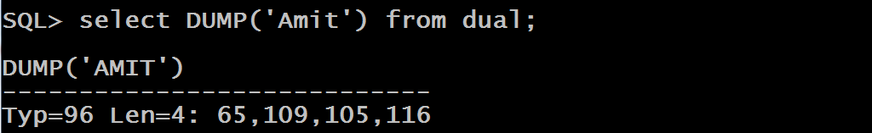
The Function DUMP()
This function returns a varchar2 value that includes the datatype code, the length in bytes, and the internal representation of the expression.
Syntax
DUMP(string)
Example

Slide 6
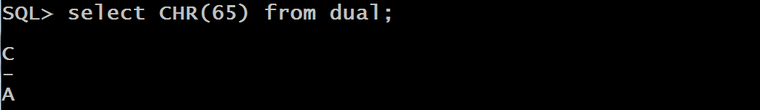
The Function CHR()
This function returns the character of given Ascii Number
Syntax
CHR(numeirc_value)
Example

Slide 7
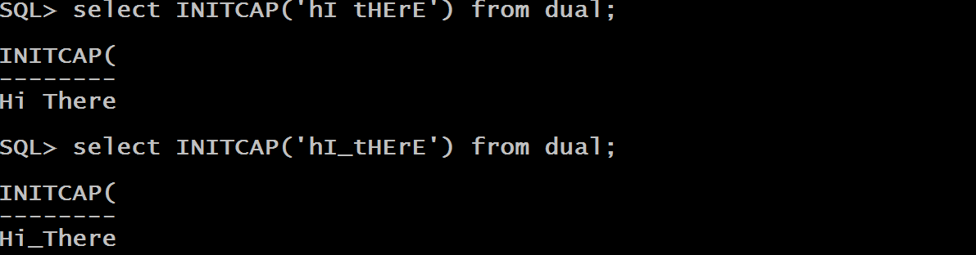
The Function INITCAP()
This function converts the first letter of each word to uppercase and other letters to lowercase.
Syntax
INITCAP(string)
Example

Slide 8
The Function INSTR()
This function searches for a substring in a string and returns the position of the substring in a string.
Syntax
INSTR(main_string,sub_string,[start_pos],[no_of_occ])
Arguments
main_string: The string or character expression that contains the substring to be searched
sub_string: The string or character expression that is to be searched
start_pos: A nonzero integer that specifies where in the string the INSTR() function begins to search. If it is positive , then search starts from beginning and if it is negative , searching starts from the end. Default is 1

Slide 9
The Function INSTR()
no_of_occ: A positive integer that specifies which occurrence of the substring the INSTR() function should search. Its default value is 1
Return Value:
The INSTR() function returns a positive integer that is the position of the substring within the main string.
If the main string does not contain the substring, the INSTR() function returns 0 (zero).

Slide 10
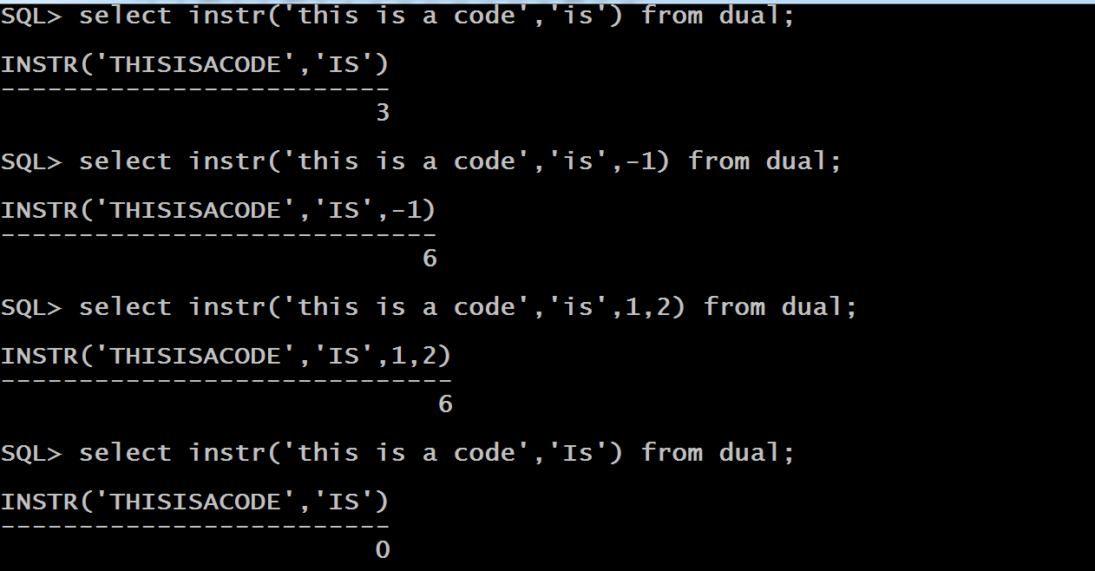
Examples

Slide 11
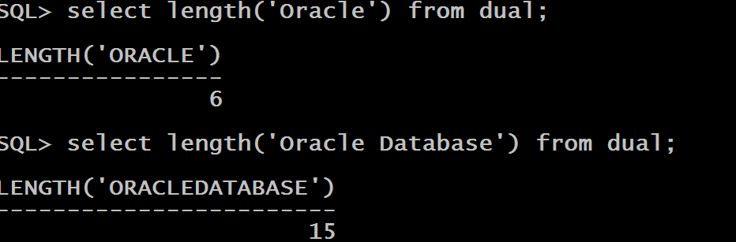
The Function LENGTH()
This function returns the number of characters of a specified string.
Syntax
LENGTH(string)
Example

Slide 12
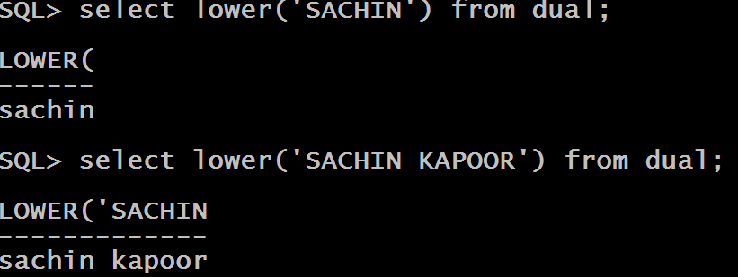
The Function LOWER()
This function converts all letters in a string to lowercase.
Syntax
LOWER(string)
Example

Slide 13
The Function LPAD()
This function returns a string left-padded with specified characters to a certain length.
Syntax
LPAD(source_string,length,padding_string)
Arguments
source_string: The string that will be padded from the left end.
length: The length of the result string after padding.
padding_string: The string to be padded

Slide 14
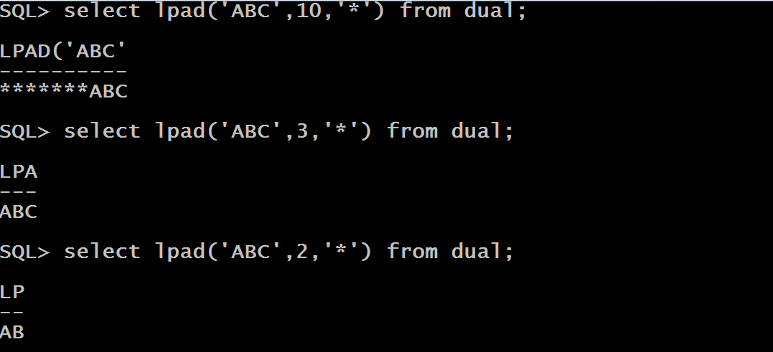
Examples

Slide 15
The Function LTRIM()
This function removes all specified characters from the left-end of a string.
Syntax
LTRIM(main_string,trim_string)
Arguments
main_string: The string that will be trimmed.
trim_string: The string that will be removed from the left-hand side of main_string . If this parameter is omitted, the LTRIM function will remove all leading spaces from main_string

Slide 16
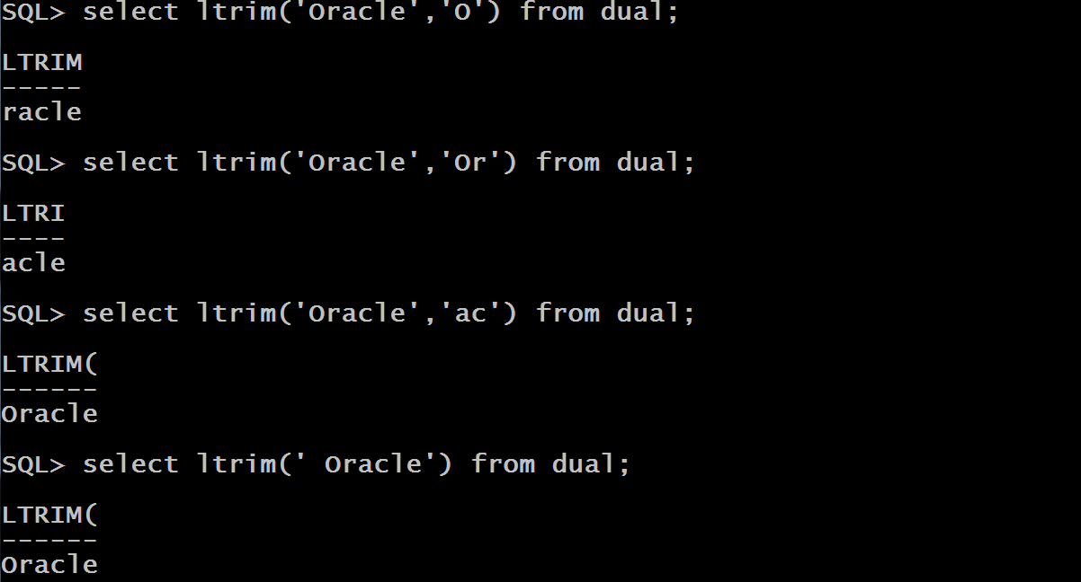
Examples

Slide 17
The Function REPLACE()
This function replaces all occurrences of a specified substring in a string with another.
Syntax
REPLACE(main_string,old_string,new_string)
Arguments
main_string: The string in which replacement will take place
old_string: The string that will be replaced
new_string: The string that will be inserted in the main_string in place of old_string. wIf this parameter is omitted then the function REPLACE removes all the occurrences of the old_string from the main_string

Slide 18
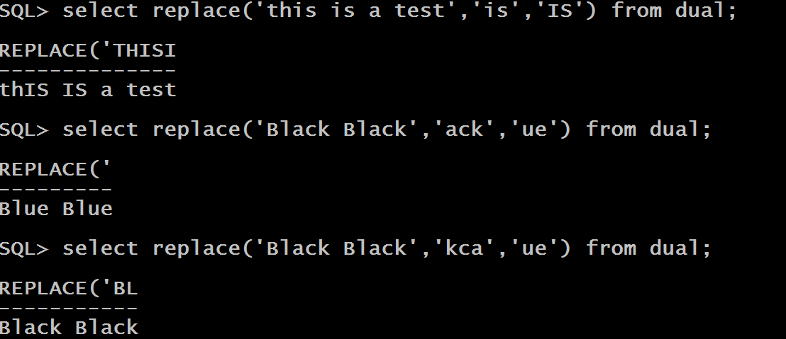
Examples

Slide 19
The Function RPAD()
This function returns a string right-padded with specified characters to a certain length.
Syntax
RPAD(source_string,length,padding_string)
Arguments
source_string: The string that will be padded from the rightend.
length: The length of the result string after padding.
padding_string: The string to be padded

Slide 20
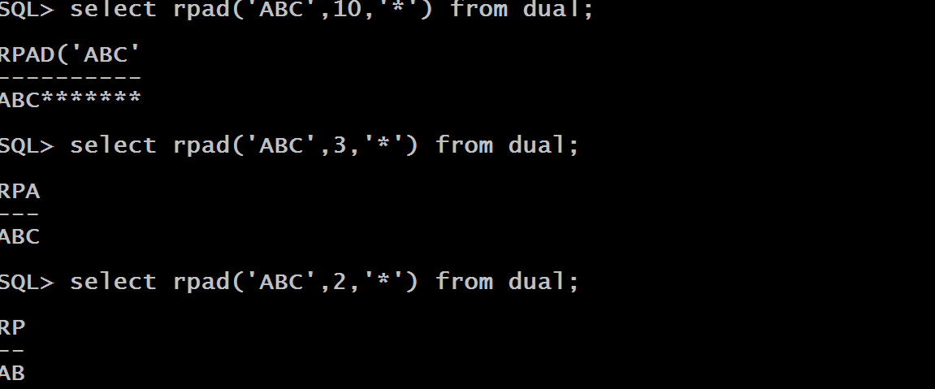
Examples

Slide 21
The Function RTRIM()
This function removes all specified characters from the right-end of a string.
Syntax
RTRIM(main_string,trim_string)
Arguments
main_string: The string that will be trimmed.
trim_string: The string that will be removed from the right-hand side of main_string . If this parameter is omitted, the RTRIM function will remove all ending spaces from main_string

Slide 22
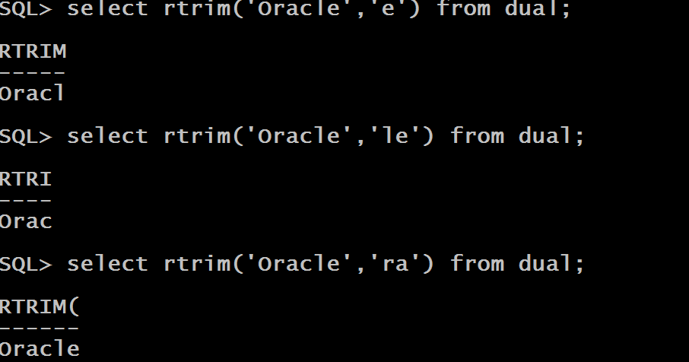
Examples

Slide 23
The Function SUBSTR()
This function extracts and retuns a substring from a string.
Syntax
SUBSTR(main_string,start_pos,length)
Arguments
main_string: The string from which extraction will be done
start_pos: The starting position of extraction .If it is positive then counting begins from the start of the string and if it is negative then counting begins from the end.
length: The number of characters to b extracted. If it is omitted then the while string from the start_pos is returned.

Slide 24
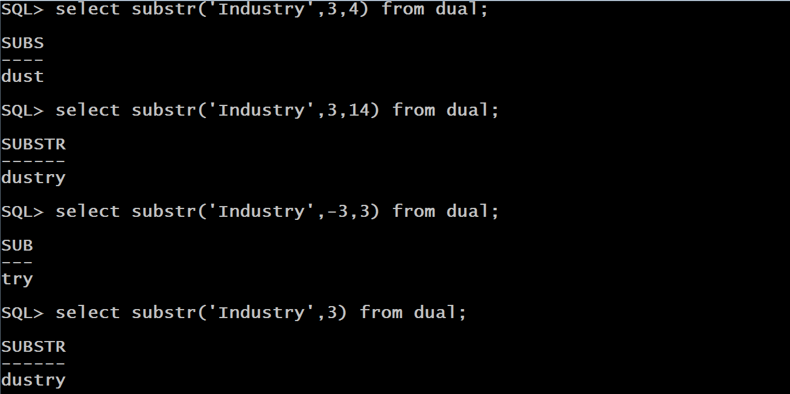
Examples

Slide 25
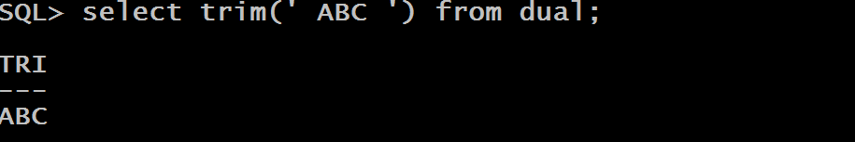
The Function TRIM()
This function removes all whitespaces from the beginning as well as the end of a string.
Syntax
TRIM(main_string)
Example

Slide 26
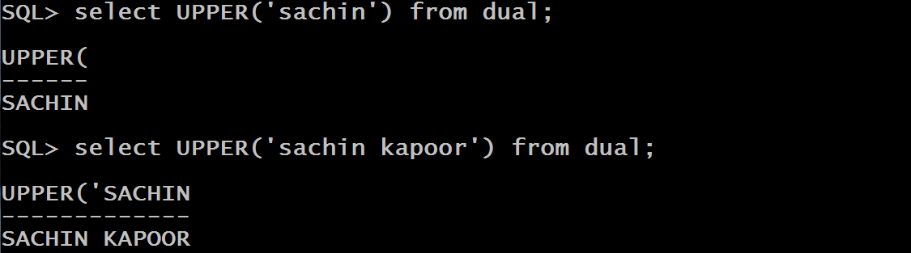
The Function UPPER()
This function converts all letters in a string to uppercase.
Syntax
UPPER(string)
Example

Slide 27
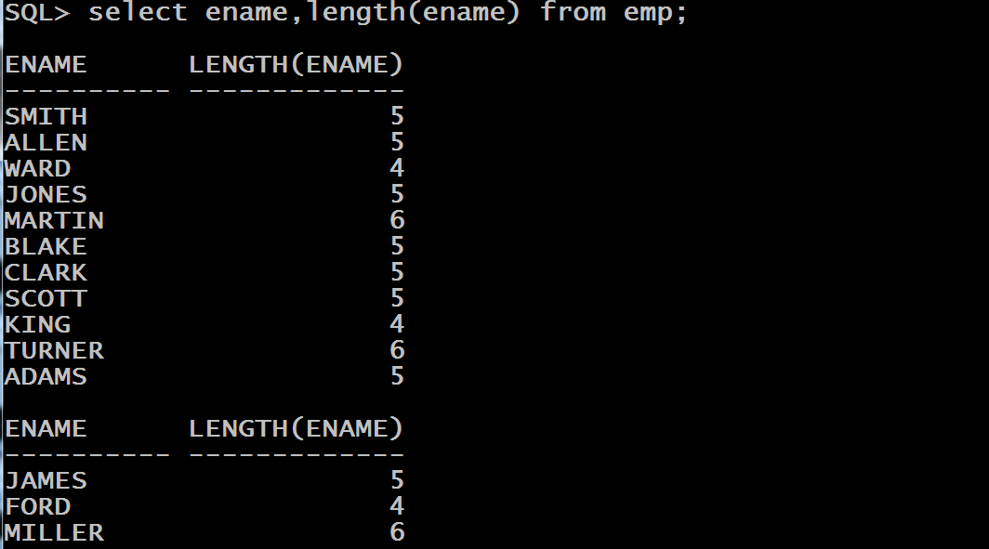
Queries
WAQ to display name of every employee as well as its length from the EMP table.

Slide 28
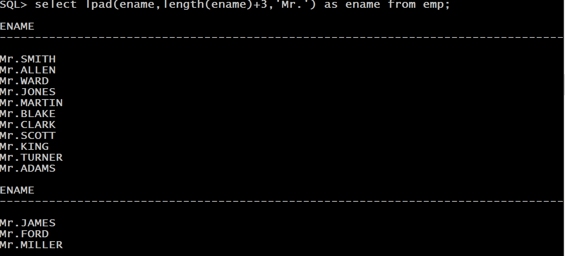
Queries
WAQ to display name of every employee prefixed with Mr. from the EMP table.

